Slide 1
Elementary Cellular Automaton
Presented 9/28/2015
Nik Clarkson
@CaptainArkansas

Slide 2
Cellular Automata
A grid of cells
A list of possible states for a single cell
A collection of rules governing state transitions

Slide 3
Cellular Automata aren’t just simulations
They can do computations
Propagating structures are like signals interacting
They can act as universal computers

Slide 4
Elementary Cellular Automata
Only 2 cell states
One dimension
One rule ( OK well maybe more than one…)

Slide 5
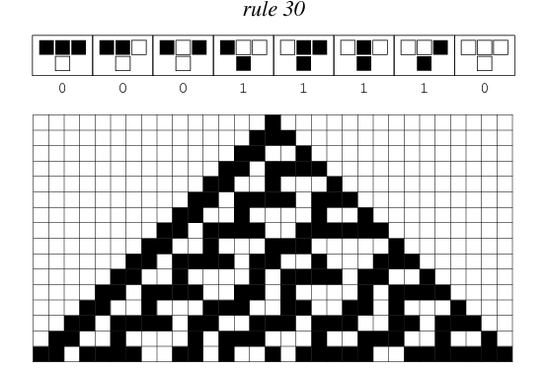

Slide 6
